Slide 1




Climate Drivers of Invasive Plant Phenology
Diego Huerta, Katharine Gerst

Slide 2
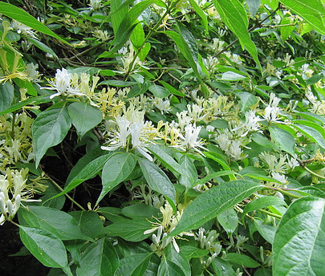
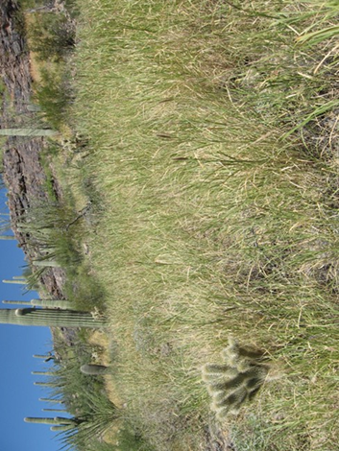
Invasive Plant Phenology
Treatment timing
  Herbicides
  Mowing/Cutting
Invasiveness
  Earlier/Later flowering
  Earlier leafing
Photos: Leonore Enking, NPS

Slide 3
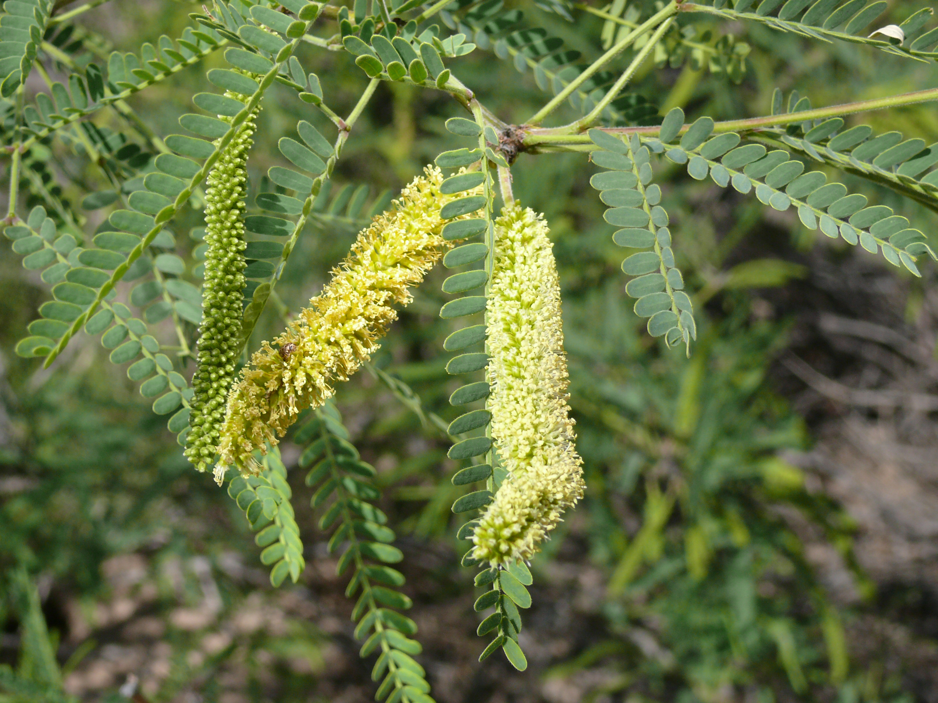
Objectives
Examine the availability of invasive plant records
Identify climate patterns in invasive phenology
Photos: Sue in AZ

Slide 4
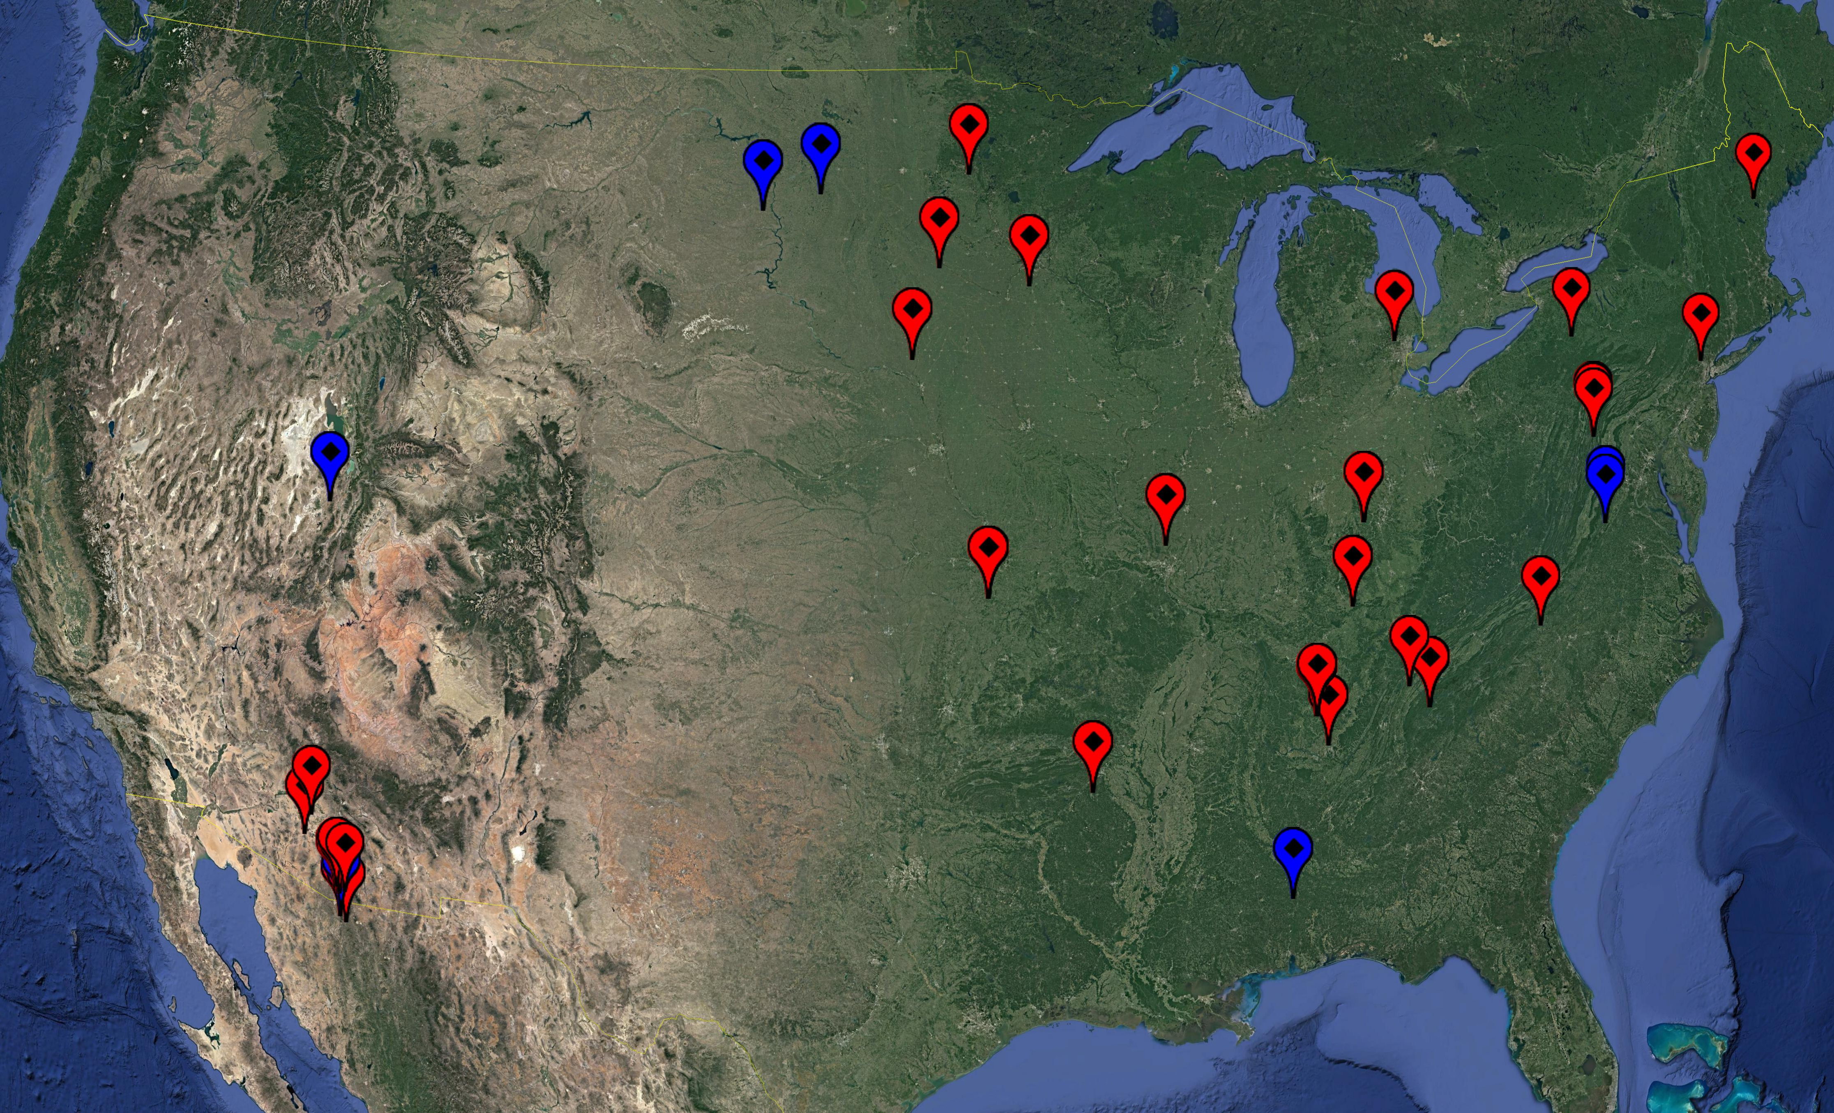
Sources of Phenology Data
NPN Sites
NEON Sites
National Phenology Network (NPN)
  Less consistent records
  More sites and years of data
National Ecological Observatory Network (NEON)
  More consistent records
  Few sites and years of data
Both collect phenology data using the same standardized protocols

Slide 5
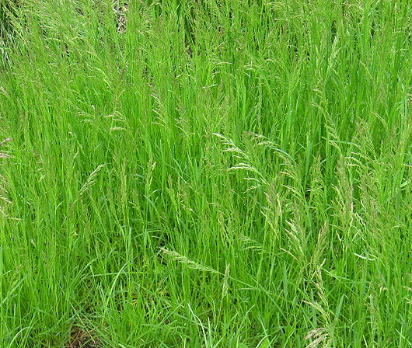
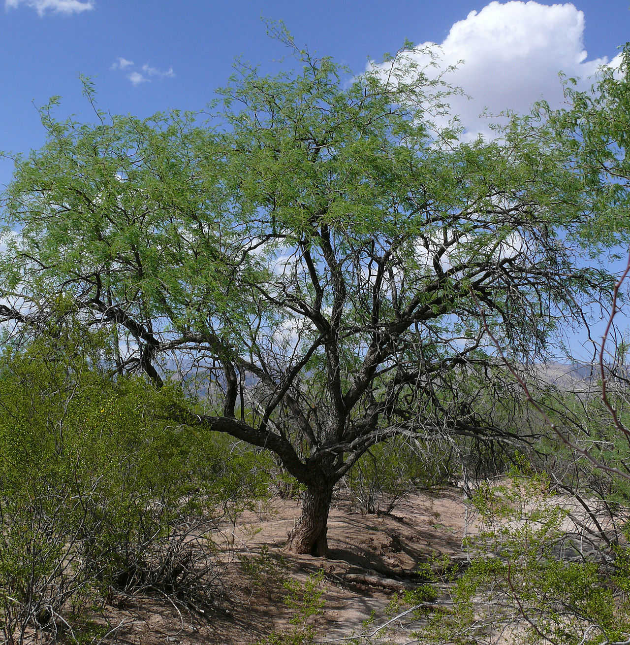
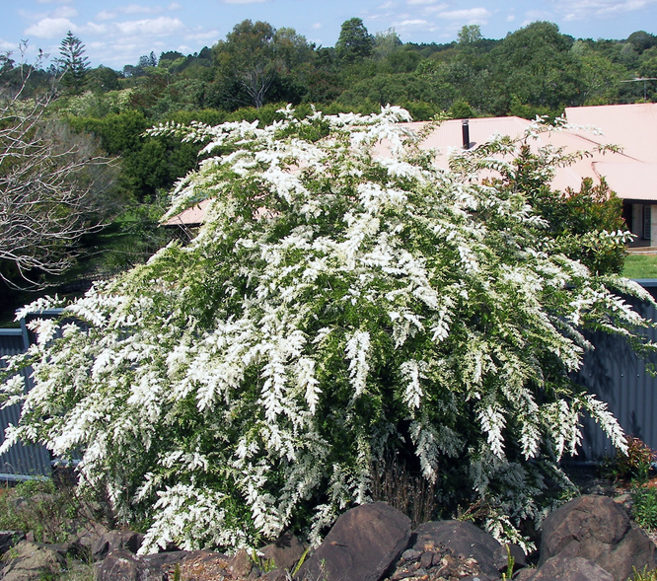
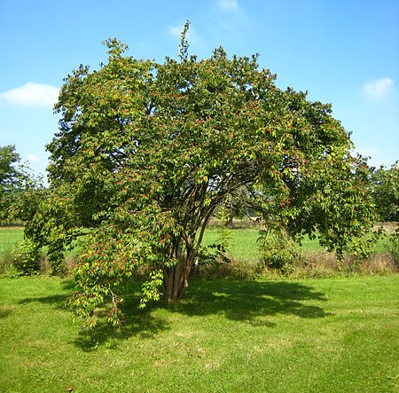
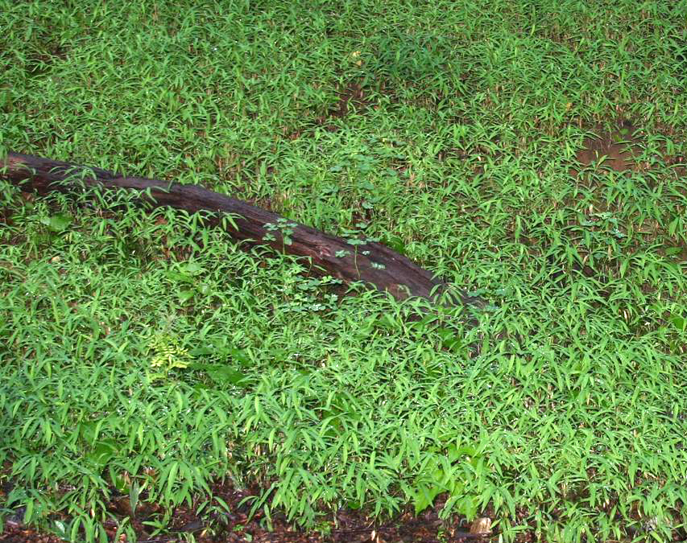
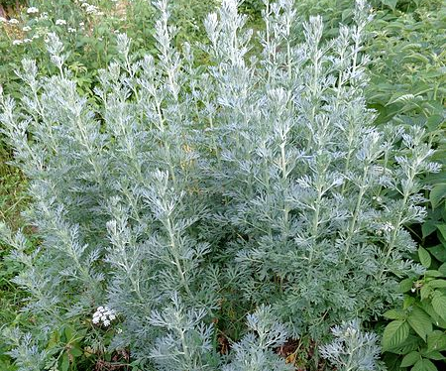
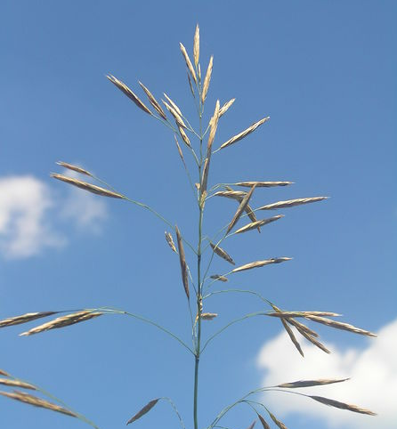
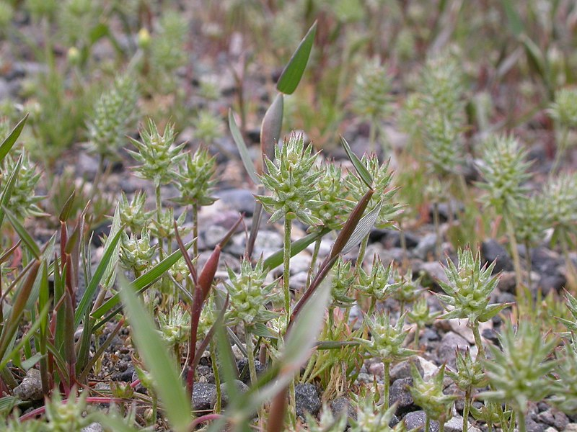
Species
Poa pratensis
(Kentucky Bluegrass)
Prosopis velutina
(Velvet Mesquite)
Ligustrum sinense
(Chinese privet)
Lonicera maackii
(Amur Honeysuckle)
Microstigium vimineum
(Japanese Stiltgrass)
Artemesia absinthium (Common Wormwood)
Bromus inermis
(Smooth Brome)
Ceratocephala testiculata (Bur Buttercup)
Photos (as read): Public Domain, Sue in AZ, Jane Gibbs, Mattieu Sontag, Leslie Mehrhoff, Aleksandrs Balodis, Petr Filippov, Matt Lavin

Slide 6
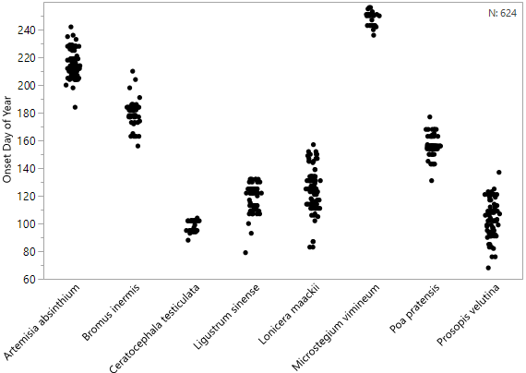
Methodology
Onset of Flowering
1631 Total Onset Records
  8 Species
  Flowers + Leaves
Climate data
  Precipitation and minimum/maximum temperatures for prior 6 months
  Reduced with Principle Components Analysis (PCA)
Multiple regression on 3 principle components

Slide 7
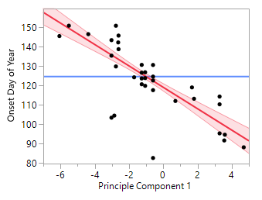
Model Interpretation: L. maackii
Component 1 Factor Loadings
Flowering vs Component 1
Lonicera maackii
(Amur Honeysuckle)
Increasing temperatures

Slide 8
Conclusions and Discussion
75% of models significant at α = 0.01
Records expansion in space and time can improve models, and make more models available
  More robust datasets required to make models more generalizable
  Lack of invasive species records
Next Steps
  Incorporate more variables
  Deliver results to land managers

Slide 9
Acknowledgements
Dr. Katharine Gerst – Mentor
USA-NPN staff – Advice and feedback
University of Arizona NASA Space Grant Program
Katie Jones - NEON contact

